Slide 1


Mastering Website Hosting with Azure
How to Host and Manage Websites Using Microsoft Resources:
Host: Madina Javed Iqbal (Frontend Developer, Alpha MLSA)
Co-Host: Abu Bakar Sattar
(Python Developer, Beta MLSA)

Slide 2

What is Azure?
Microsoft’s cloud computing platform.
Provides a comprehensive suite of services for hosting websites, applications, and databases.
Offers scalability, security, and global reach.

Slide 3
Why Use Azure for Hosting?
Scalability: Adjust resources based on traffic needs.
Global data center: Fast performance for users worldwide.
Built-in security: Compliant with industry standards and regulations.

Slide 4
Azure Services for Website Hosting :
Azure App Service
Azure Virtual Machines
Azure CDN
Azure Storage

Slide 5
Creating an Azure Account
01
Go to https://azure.microsoft.com/en-us/ and sign up for a free account.
02
Access the Azure portal to manage your resources.
03
Explore free services available for new users.

Slide 6
Creating an Azure Account
01
Go to https://azure.microsoft.com/en-us/ and sign up for a free account.
02
Access the Azure portal to manage your resources.
03
Explore free services available for new users.

Slide 7

Deploying a Website Using Azure App Service:
Create a new App Service instance in the Azure portal.
Choose the appropriate framework (Node.js, .NET, Python, etc.)
Deploy your code using GitHub integration or FTP.

Slide 8
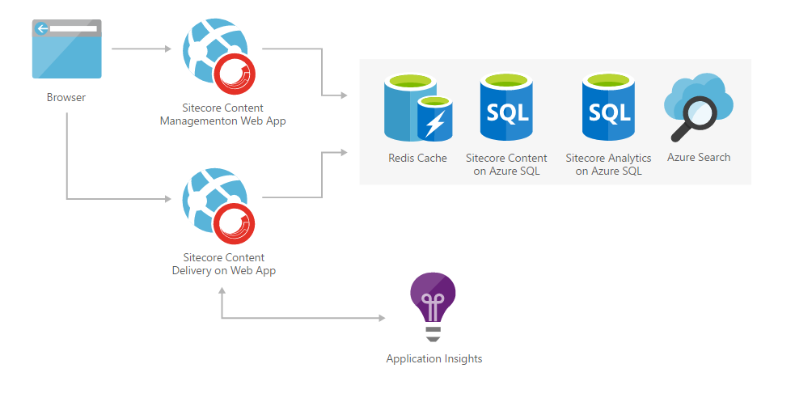
Azure Hosting For Web Apps:

Slide 9
Managing and Monitoring:
Utilize the Azure Portal for website management
Use Azure Monitor to track site performance and health.

Slide 10
Azure DevOps Integration
01
Automate deployment with Azure Pipelines for continuous integration and delivery.
02
Collaborate with teams using Azure Repos and Boards.
03
Monitor changes and maintain version control.

Slide 11

Q&A and Next Steps

Slide 12

THANK YOU

